Slide 1
Phase 1

Slide 2
https://github.com/AbiParekh/phase-1
Workflow
File Name
Map()
(E-man)
Sorting Class
(stephen)
Reduce Class
(Abhi)
Line
Output: “(The, 1)”, “(is,1)”
File Management
(Stephen)

Slide 3
std::vector<std::string>InputVector
Sorter
std::vector<std::string>OutputVector
Input File (“a”,1),(“the”,1),(“is”,1),(“the”,1),(“a”,1)
Output File
(“a”,[1,1]),(“the”,[1,1]),(“is”,[1])
Does the output Sorting Function have to write the data to an intermediate file?

Slide 4
Phase 2

Slide 5
✅
Map
MapClass.h. (MapLibrary.h)
Map(Derived Class) inherits MapInterface.h
✅
DllMapExports.h
Extern “C”
MAPLIBRARY_API void* CreateMapClassInstance();
Includes
Includes
✅
Includes
DllMapMain.cpp
MAPLIBRARY_API void* CreateMapClassInstance(string, size_t){...}
✅
MapInterface.h.
InterfaceMap (Abstract BaseClass)
using
Includes
MapReducerWF
hdll = LoadLibrary("../../DllMap.dll"); // load the dll
CreateFoo = static_cast <pvFunctv> (GetProcAddress(hdll, "_CreateMapClassInstance"));
Notes:
DoReduce

Slide 6
Reduce
ReduceClass.h.
Reducer(Derived Class) inherits MapInterface.h
DllReduce.h
void* IMPEXP CreateReduceClassInstance();
Includes
Includes
Includes
DllReduce.cpp
void* IMPEXP CreateReduceClassInstance(){...}
ReduceInterface.h.
IReducer (Abstract BaseClass)
Includes
MapReducerWF
hdll = LoadLibrary("../../DllReduce.dll"); // load the dll
CreateFoo = static_cast <pvFunctv> (GetProcAddress(hdll, "_CreateReduceClassInstance"));

Slide 7
Phase 3

Slide 8
Work Flow (Finalize Class)
Workflow
Map
Reducer
Is this an Acceptable Approach?
Will this set us up for the last phase?
Map
Sort/Reduce
Map
Sort/Reduce
Merge
(Key)
Map
Sort/Reduce
Divide up Files and assign Unique Files to Threads.
Create Threads with an unique Map Library
Call Map Function where there are R Groupings of output files
Join Map Threads
Identify Files for each Reduce
Create R Threads and provide unique file list
Call Reduce Function where a single file is created for Each R
Join Reduce Threads
Additional Finalize class reads all Reduce Files and creates a Single Output
Write Success File.txt
Read Configuration File and Build and launch Worker Class
Intro Setup
Map Stage
Sort/Reduce Stage
Finalize Stage
Config File
Map
DLL
Input File 1
Reduce
DLL
R1 File
Output File
Input File 2
Input File 3
Input File 4
Input Files
R2 File
File X.X
File X.X
File X.X
Success File
R1 Files
R2 File
R3 File
R3 File

Slide 9
Work Flow (Merge Sorted R Files)
Workflow
Map
Reducer
Is this an Acceptable Approach?
Will this set us up for the last phase?
Map
Reduce
Map
Sort/Merge
Reduce
Map
Config File
Reduce
Create Threads with an unique Map Library
Divide up Files and assign Unique Files to Threads.
Call Map Function where there are R Groupings of output files
Join Map Threads
Reducer Threads are started and the corresponding files are provided
Reducer threads write to the same output file and return when completed
Join Reduce Threads
Write Success
Read Configuration File and Build and launch Worker Class
A Sorter Class creates a single merged set of data.
Merge set of Data is split into R files
Intro Setup
Map Stage
Sort/Merge Stage
Reducer Stage
Config File
Map
DLL
Input File 1
Reduce
DLL
R1 File
Output File
Input File 2
Input File 3
Input File 4
Input Files
R2 File
Map DLL Location
Reduce DLL Location
Input Folder
Middle Folder (Opt)
Output Dir (Opt)
# of Map Threads (N)
# of Reduce Threads (R)
File X.X
File X.X
File X.X
R3 File
Success File
R1 Files
R2 File
R3 File

Slide 10
The user specified number of R threads will determine the number of output files and the mapping of words to each output file.
Reduced Threads: | ASCII Character Mapping:
R = 3 | ‘a’{97} mod R{3} = 1 -> R1 ‘b’{98} mod R{3} = 2 -> R2 ‘c’{99} mod R{3} = 0 -> R0
R1_SomeFile.txt : … (“apple”, 1) ...
R2_SomeFile.txt : … (“banana”, 1) …
R0_SomeFile.txt : … (“carrot”, 1) ...
(“SomeFile.txt”, “apple, banana, carrot”)

Slide 11

Phase Four
Emmanuel, Stephen, Abhishek
Object Oriented Programming
Faculty of Engineering and Computer Science
December 14th, 2022
Professor:
Dr. Scott Roueche

Slide 12
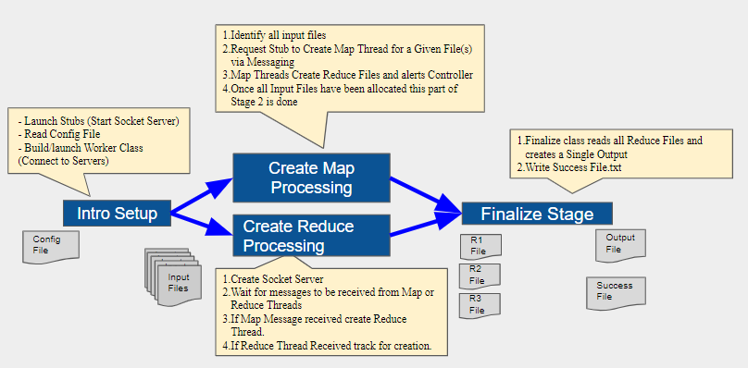
Workflow (Finalize class)

Slide 13
Control Flow
Config
Heartbeat K (seconds)
Stubs N (# of stubs)
filePath inputDir
Controller
# of files mod(stubs)
SocketConnector
Stub 1
Stub N
SocketListener
Stub 2
…
Mapper 1
Mapper 2
Mapper 3
Mapper 4
Reducer 1

Slide 14
Control Flow
Objective of the controller is to manage flow of messaging
From stubs to Map & Reducer libraries
The controller writes message to be sent between stubs to kick of the workflows and begin processing Map or Reduce. Controller listens to for heartbeat messages for status updates from Map/Reduce every K seconds.
Controller Messages:
Inbound Messages: “Waiting” | “Processing” | “Stopped”
Outbound Messages: “Start Mapper#” | “Start Reducer#” | “Stop”
Notes:
The Controller manages the flow of messaging between the stubs and Map and Reducer library’s. The controller writes message to be sent between stubs to kick of the workflows and begin processing Map or Reduce. Controller listens to for heartbeat messages for status updates from Map/Reduce every K seconds.
Controller Messages:
Inbound Messages: “Waiting” | “Processing” | “Stopped”
Outbound Messages: “Start Mapper#” | “Start Reducer#” | “Stop”

Slide 15
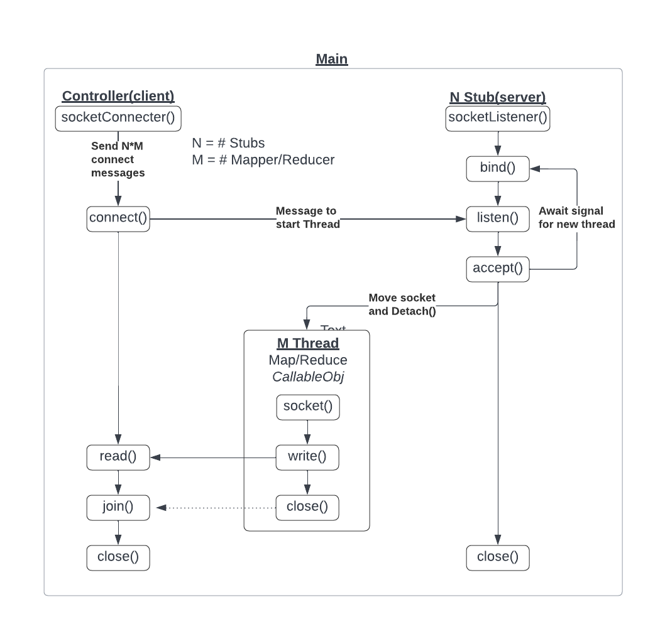
Messaging

Slide 16
Main
GenerateStubs
ExecuteController(ControllerConfig)
Msg
Direct Ownership
Creates
Controller
- MapFiles(InputDirectoy)
- ReduceFile(SingleReduceFile)
- FinializeOutput
Creates/Joins
StubN
-ProcessMessage
-CreateReduceThread
-CreateMapThread
-JoinAllThreads
CreateThreadMsg
JoinThread
Creates/Joins
Creates/Joins
Reduced File
Reduce Thread
Map Thread
MappedFile

Slide 17
SOCKET Diagram
Config File
CreateThreadMsg (Type, Filename)
Controller
Client
Input
CreateThreadMsg (...)
Client
CreateThreadMsg (...)
Server
Client
STUB
Server
STUB
Server
STUB
Server
Thread/Call
Msg
Mapper
Reducer
MapMessage/Heartbeat
Client
Client
ReduceMsg/Heartbeat
Creates
Creates
MAIN Function

Slide 18
Phase 4

Slide 19
Work Flow (Finalize Class)
Identify all input files
Request Stub to Create Map Thread for a Given File(s) via Messaging
Map Threads Create Reduce Files and alerts Controller
Once all Input Files have been allocated this part of Stage 2 is done
- Launch Stubs (Start Socket Server)
- Read Config File
- Build/launch Worker Class (Connect to Servers)
Finalize class reads all Reduce Files and creates a Single Output
Write Success File.txt
Create Map Processing
Intro Setup
Finalize Stage
Create Reduce Processing
Config File
R1 File
Output File
Input File 1
Input File 2
Input File 3
Input File 4
R2 File
Input Files
Create Socket Server
Wait for messages to be received from Map or Reduce Threads
If Map Message received create Reduce Thread.
If Reduce Thread Received track for creation.
Success File
R3 File

Slide 20
Control flow
The Controller manages the flow of messaging between the stubs and Map and Reducer library’s. The controller writes message to be sent between stubs to kick of the workflows and begin processing Map or Reduce. Controller listens to for heartbeat messages for status updates from Map/Reduce every K seconds.
Config
Heartbeat K (seconds)
Stubs N (# of stubs)
filePath inputDir
Controller
# of files mod(stubs)
SocketConnector
Stub 1
Stub 2
Stub N
SocketListener
…
Mapper 1
Mapper 2
Mapper 3
Mapper 4
Reducer 1
Controller Messages:
Inbound Messages: “Waiting” | “Processing” | “Stopped”
Outbound Messages: “Start Mapper#” | “Start Reducer#” | “Stop”

Slide 21
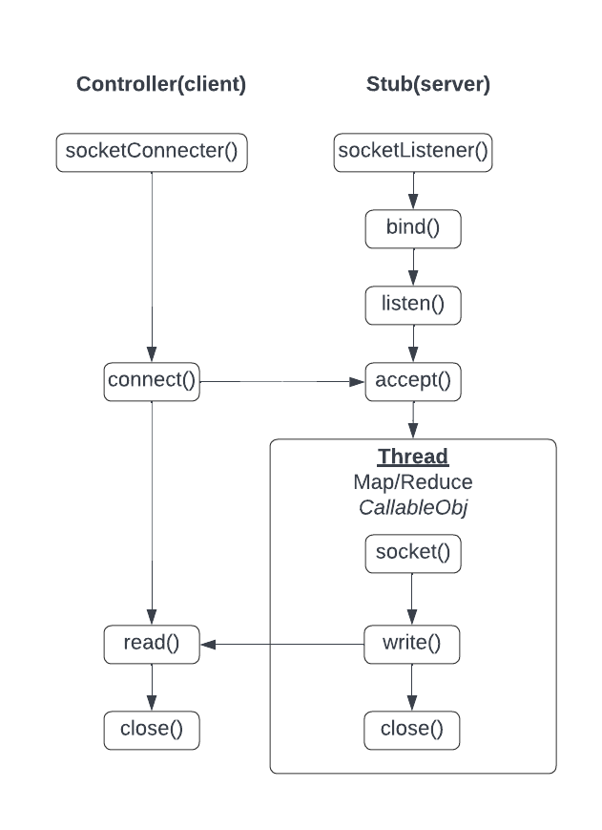
Messaging

Slide 22
Main
GenerateStubs
ExecuteController(ControllerConfig)
Msg
Direct Ownership
Creates
Controller
- MapFiles(InputDirectoy)
- ReduceFile(SingleReduceFile)
- FinializeOutput
Creates/Joins
StubN
-ProcessMessage
-CreateReduceThread
-CreateMapThread
-JoinAllThreads
CreateThreadMsg
JoinThread
Creates/Joins
Creates/Joins
Reduced File
Reduce Thread
Map Thread
MappedFile

Slide 23
SOCKET Diagram
Config File
CreateThreadMsg (Type, Filename)
Controller
Client
Input
CreateThreadMsg (...)
Client
CreateThreadMsg (...)
Server
Client
STUB
Server
STUB
Server
STUB
Server
Thread/Call
Msg
Mapper
Reducer
MapMessage/Heartbeat
Client
Client
ReduceMsg/Heartbeat
Creates
Creates
MAIN Function

